Slide 1
Hamming Code Error detection and Correction
Namrata Ahuja
2020B2A81978G

Slide 2
Error Detection And Correction
The small size of the transistors, combined with cosmic ray effects causes occasional errors in stored information in large, dense RAM chips.
These errors can be detected and corrected by employing error-detecting and –correcting codes in RAMs

Slide 3
Parity Bit
To detect errors in data communication and processing, an additional bit is sometimes added to a binary code word to define its parity.
A parity bit is the extra bit included to make the total number of 1’s in the resulting code word either even or odd.

Slide 4
Parity Bit Example
 | With Even Parity | With Odd Parity
1000001 7 bits | 01000001 8 bits | 11000001
1010100 | 11010100 | 01010100

Slide 5
Characteristics of Parity
Even parity is more common
Parity may be used with binary numbers as well as with codes including ASCII
The parity bit may be placed in any fixed position in the code

Slide 6
Parity Bit Generating and Checking
An even parity bit is generated at the sending end for all 7-bit ASCII characters
The 8-bit characters including the parity bits are transmitted to their destination
The parity of each character is then checked at the receiving end
If the parity of the received character is not even (assuming even parity is used), at least one bit has changed its value during the transmission

Slide 7
Pros & Cons
If the number of bits changed is even, the error will not be detected.
It can only detects one, three, or any odd number of errors in each character.
Parity does not indicate which bit contained the error, even when it can detect it.
The data must be discarded entirely, and re- transmitted from scratch.
It uses only a single bit, resulting in the least overhead.

Slide 8
Hamming Codes
The most common types of error-correcting codes used in RAM are based on the codes devised by R.W. Hamming.
K parity bits are added to an n-bit data word, forming a new word of n + k bits.
The bit positions are numbered in sequence from 1 to
n + k.
Those positions numbered with powers of two are reserved for the parity bits.
The code can be used with words of any length

Slide 9
4 Parity Bits
Can provide error correction for five to eleven data bits.
A (12,8) code offers a reasonable compromise in the bit stream
Why (12,8) code is desirable ?
The code enables data link packets to be constructed easily by permitting one parity byte to serve two data bytes.

Slide 10
Example (12,8)
Assume a 8-bit data word 11000100. We include 4 parity bits with this word and arranged the 12 bits as above.

Slide 11
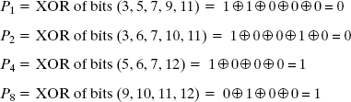
Calculating Parity Bits
We’re using Even Parity.

Slide 12
The Entire Code
The 8-bit data word is written into the memory together with the 4 parity bits as a 12-bit composite word.
Substituting the 4 parity bits in their proper positions, we obtain the 12-bit composite word.

Slide 13
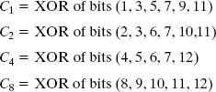
Checking
When the 12 bits are read from memory, they are checked again for errors.
The parity of the word is checked over the same groups of bits, including their parity bits

Slide 14
How to locate the error bit?
C=C₈C₄C₂C₁
If C=0, there is no error has occurred.
If C!=0, the 4-bit binary number formed by the check bits gives the position of the erroneous bit if only a single bit is in error.

Slide 15

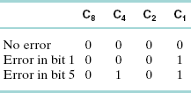
Three Cases
The error can then be corrected by complementing the corresponding bit. An error can occur in the data or in one of the parity bits.

Slide 16
Algorithm for General Hamming
All bit positions that are powers of two are used as parity bits. (positions 1, 2, 4, 8, 16, 32, 64, etc.)
All other bit positions are for the data to be encoded. (positions 3, 5, 6, 7, 9, 10, 11, 12, 13, 14, 15, 17, etc.)
Each parity bit calculates the parity for some of the bits in the code word. The position of the parity bit determines the sequence of bits that it alternately checks and skips.
Position 1 (n=1): skip 0 bit (0=n-1), check 1 bit (n), skip 1 bit (n), check 1 bit (n), skip 1 bit (n), etc.
Position 2 (n=2): skip 1 bit (1=n-1), check 2 bits (n), skip 2 bits (n), check 2 bits (n), skip 2 bits (n), etc.
Position 4 (n=4): skip 3 bits (3=n-1), check 4 bits (n), skip 4 bits (n), check 4 bits (n), skip 4 bits (n), etc.
Position 8 (n=8): skip 7 bits (7=n-1), check 8 bits (n), skip 8 bits (n), check 8 bits (n), skip 8 bits (n), etc.
Position 16 (n=16): skip 15 bits (15=n-1), check 16 bits (n), skip 16 bits (n), check 16 bits (n), skip 16 bits (n), etc.
Position 32 (n=32): skip 31 bits (31=n-1), check 32 bits (n), skip 32 bits (n), check 32 bits (n), skip 32 bits (n), etc.
General rule for position n: skip n-1 bits, check n bits, skip n bits, check n bits...
And so on.

Slide 17
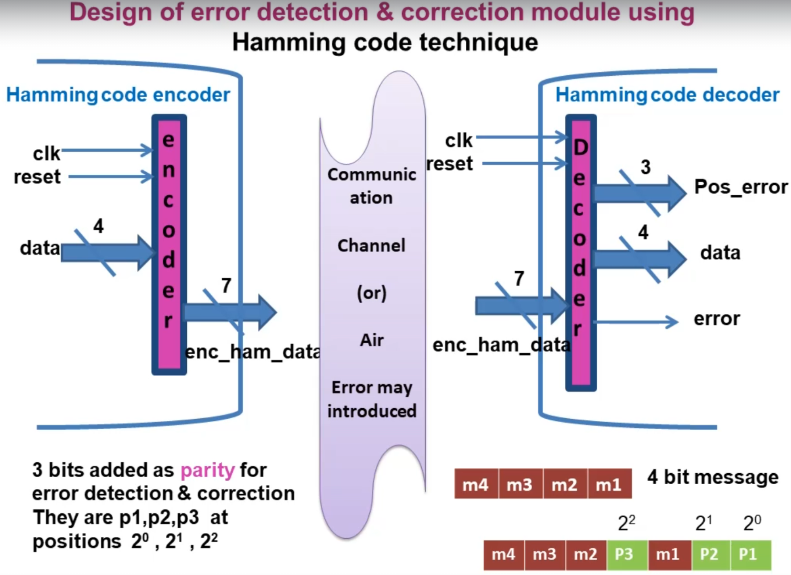

Slide 18
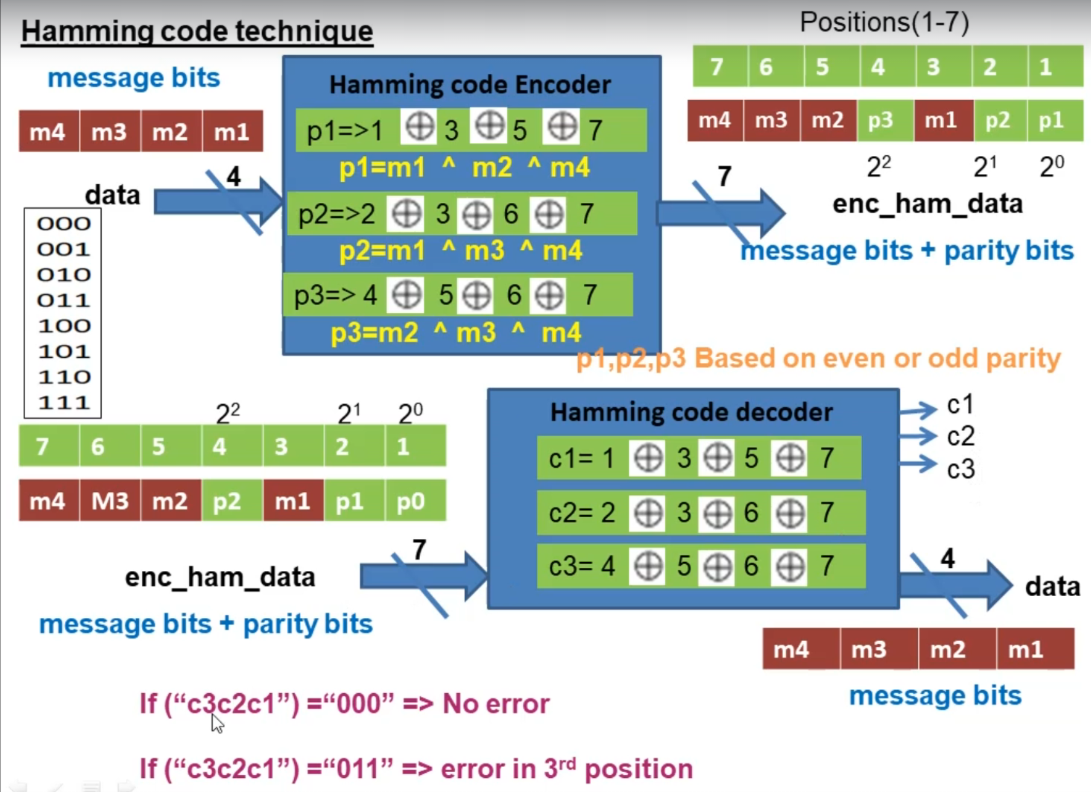

Slide 19
Hamming Encoder
Ports | Description
Input | 4 bit data
Output | 7 bit enc_ham_data

Slide 20
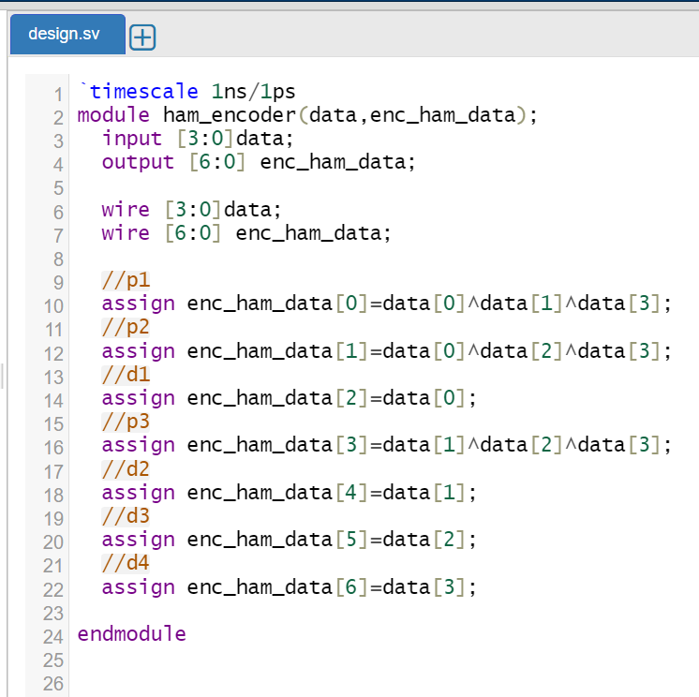
Verilog code-Initialisation and assignment

Slide 21
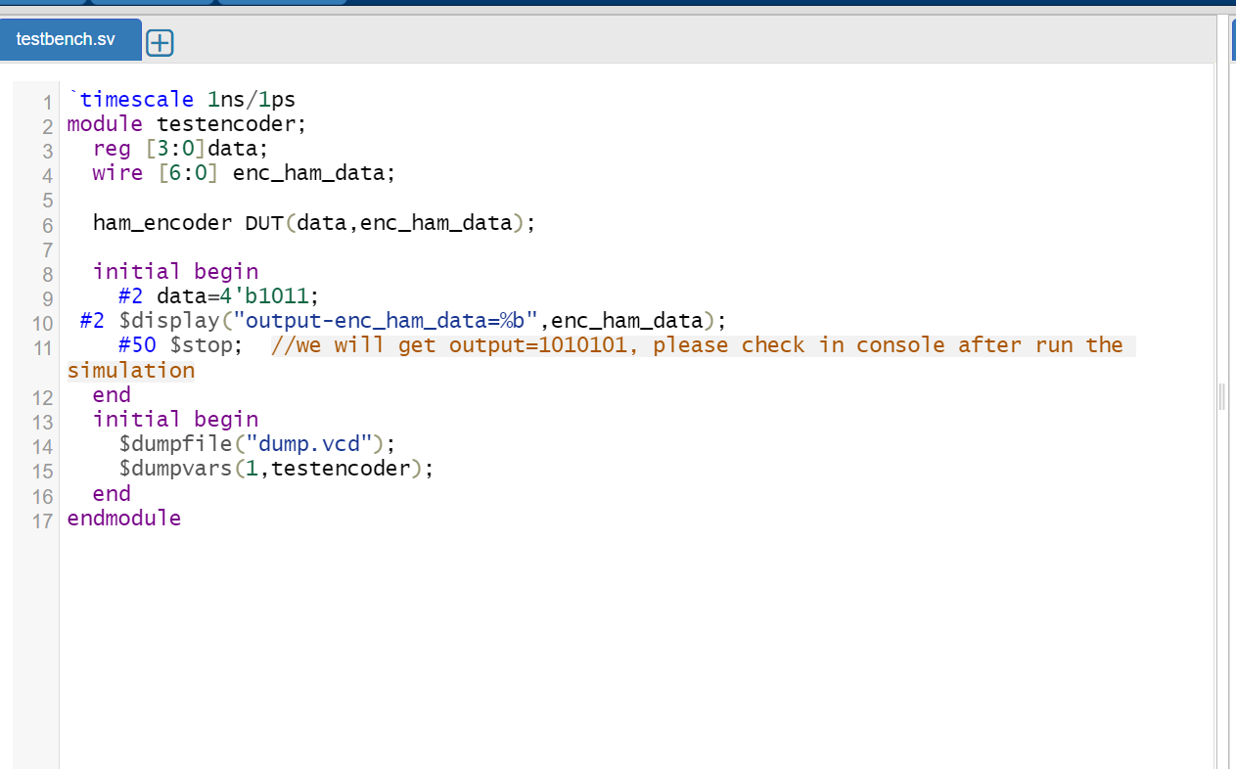
Verilog code-Testbench

Slide 22
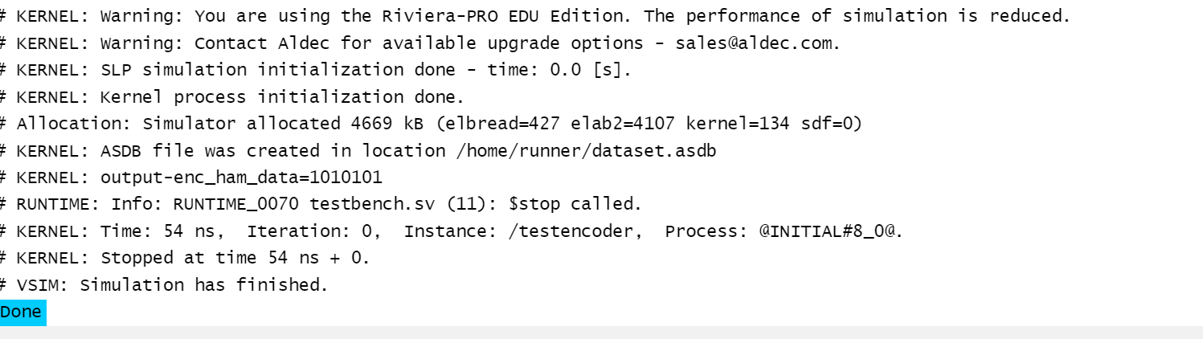
Verilog Output

Slide 23
Verilog code
https://www.edaplayground.com/x/ukVJ
https://www.edaplayground.com/x/ukVJ

Slide 24
Hamming Decoder
Ports | Description
Input | enc_ham_data
Output | 4 bit data output
 | Position of error
 | Error present or not

Slide 25
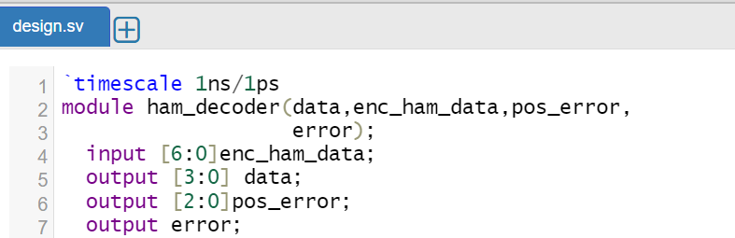
Verilog code-Initialisation

Slide 26
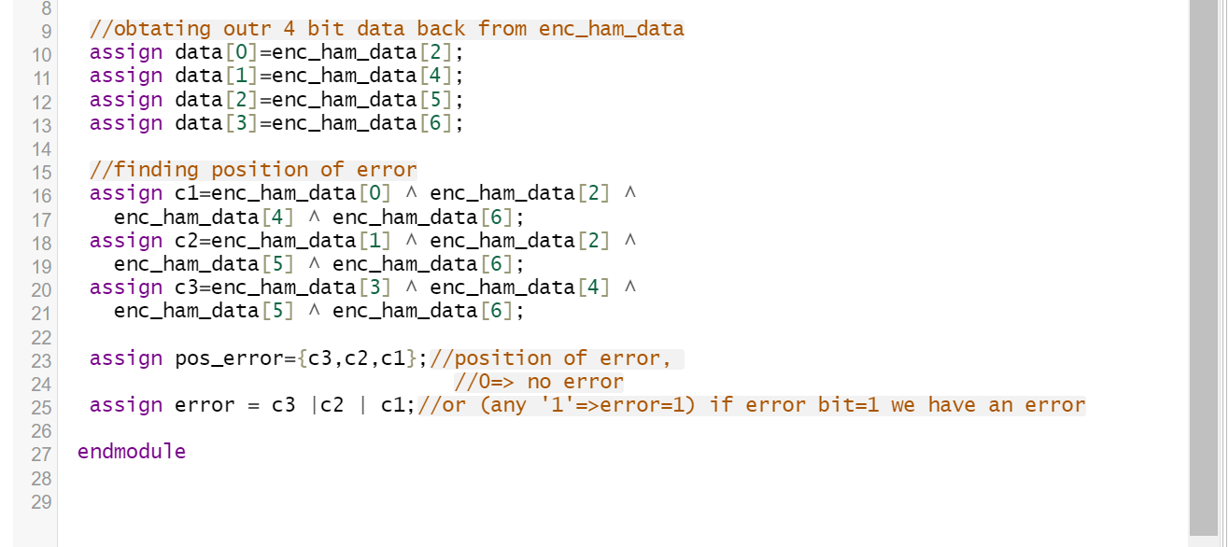
Verilog code

Slide 27
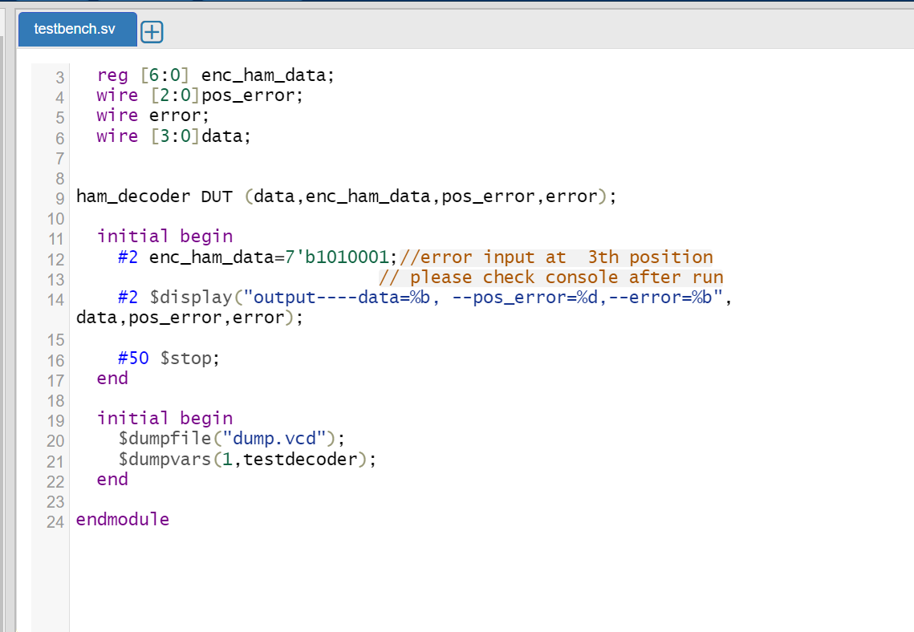
Verilog code-Testbench

Slide 28
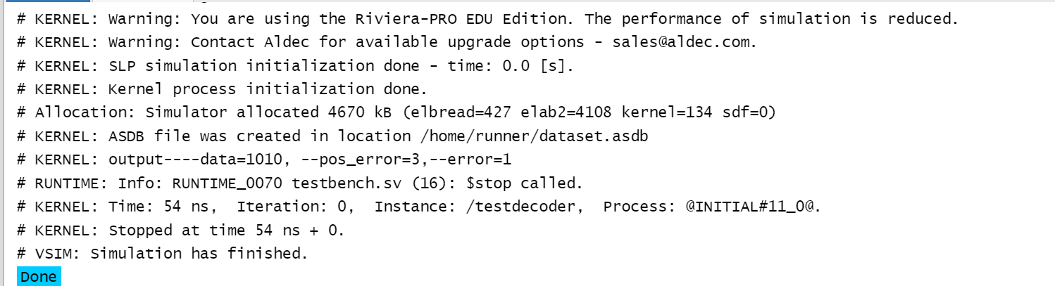
Verilog Output

Slide 29
Verilog code
https://www.edaplayground.com/x/hxva

Slide 30
Thank You

